Slide 1
ANNIS and the reference corpora of historical German
partly based on Perlitz & Odebrecht, ANNIS Einführung
RIDGES Herbology 4.1. https://www.linguistik.hu-berlin.de/de/institut/professuren/korpuslinguistik/lehre/folien-material/2015_historische_korpora (CC-BY)

Slide 2
Historical reference corpora
REA (750-1050)
Reference Corpus of Old High (and Low) German
Referenzkorous Altdeutsch
https://www.deutschdiachrondigital.de/rea/
REM (1050-1350)
Reference Corpus of Middle High German
Referenzkorpus Mittelhochdeutsch
https://www.linguistics.rub.de/rem/
REN (1200–1650)
Reference Corpus of Middle Low German / Low Rhenish - Referenzkorpus Mittelniederdeutsch / Niederrheinisch
https://www.fdr.uni-hamburg.de/record/9195
REF (1350-1650)
Reference Corpus of Early New High German
Referenzkorpus Frühneuhochdeutsch
https://www.linguistics.rub.de/ref/
Notes:
https://www.linguistics.rub.de/rem/

Slide 3
ANNIS
Another corpus query system...
developed at HU Berlin
for searching existing, annotated corpora (no inbuilt annotation function)
some basic visualization possibilities

Slide 4
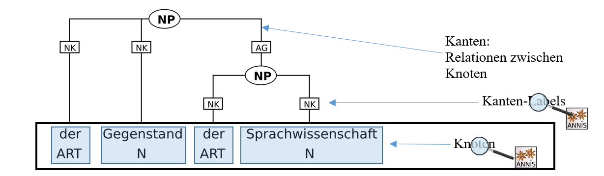
ANNIS Query Language
can search for nodes and edge labels
The latter are only available in treebanks, i.e. syntactically annotated corpora

Slide 5
ANNIS Query Language
How do I tell ANNIS what I'm looking for?
Basic principle: variable-value pairs
variable = value
e.g. pos=‎"NN‎"
and relations between variable-value pairs
pos=‎ " ART " . pos=‎"NN‎" 'followed by'
lemma=‎ "Tanzen" _=_ pos=‎"NN‎" 'congruent'

Slide 6

ANNIS Search & visualization tool
web-based search tool for corpora
project website http://annis-tools.org/
Access to web-based ANNIS tool https://korpling.german.hu-berlin.de/annis3
What can ANNIS do?
finds annotations in a corpus
finds multiple annotations in a specific relation to one another
can visualize the annotations of the hits in multiple ways
exports the hits
etc.

Slide 7
ANNIS
Examples for corpora available via ANNIS:
Referenzkorpus Altdeutsch (= Deutsch Diachron Digital; REA)
Referenzkorpora Mittel- und Frühneuhochdeutsch (REM / REF)
Refernzkorpus Mittelniederdeutsch /Niederrheinisch (REN)
RIDGES (historical herbology texts)
Notes:
CEFC = Referenzkorpus fürs Frz.

Slide 8
ANNIS
Examples for synchronic corpora in ANNIS:
Potsdamer Kommentarkorpus (Zetungskommentare)
KiezDeutschKorpus
Corpus d’Études pour le Français Contemporain (CEFC)
Georgetown University Multilayer Corpus (GUM)
Notes:
CEFC = Referenzkorpus fürs Frz.

Slide 9

Example corpus: RIDGES Herbology
Herbology corpus
15th-19th century
different dialects from the German-speaking area
annotated by ~50 students from three B.A./M.A. seminars
project website: http://korpling.german.hu-berlin.de/ridges/documentation_v4.1_en.html
Annotation guidelines
http://korpling.german.hu-berlin.de/ridges/download/pubs/annotationGuidelines_v4.1.pdf

Slide 10
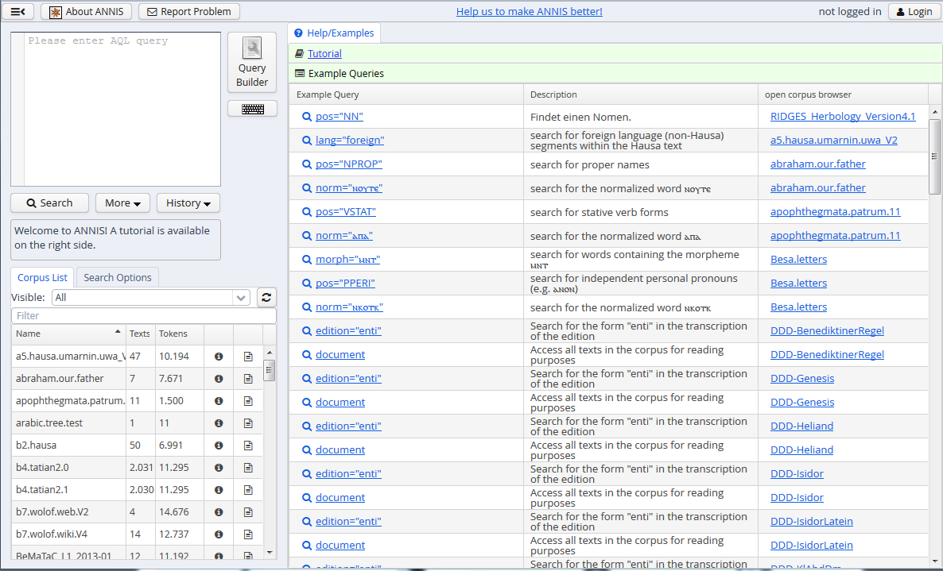
https://korpling.german.hu-berlin.de/annis3-snapshot/
https://korpling.german.hu-berlin.de/annis3-snapshot
Access: https://korpling.german.hu-berlin.de/annis3/

Slide 11
Interface
Start page, help, query window

Slide 12
Interface Start page
Tutorial & example queries
https://korpling.german.hu-berlin.de/annis3-snapshot
Example queries for all corpora in ANNIS
List of all corpora in ANNIS

Slide 13
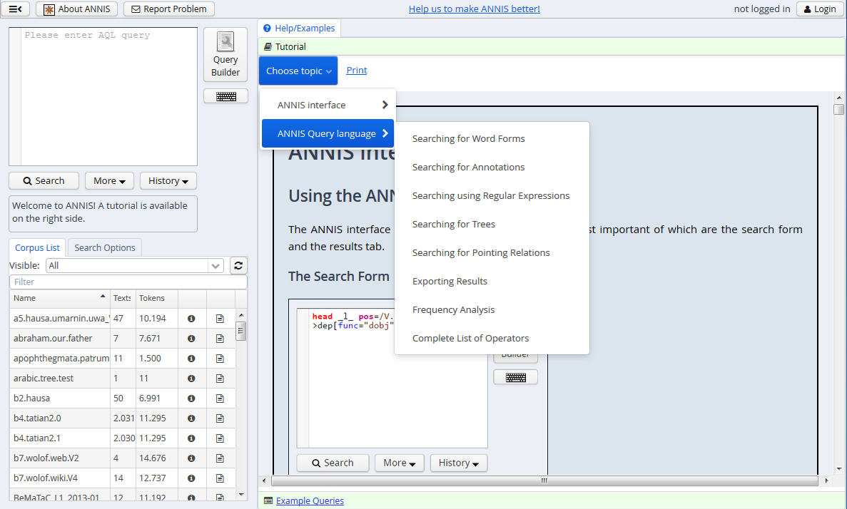
Interface Tutorial
Verschiedene Kapitel
Nicht-aktiver Reiter

Slide 14
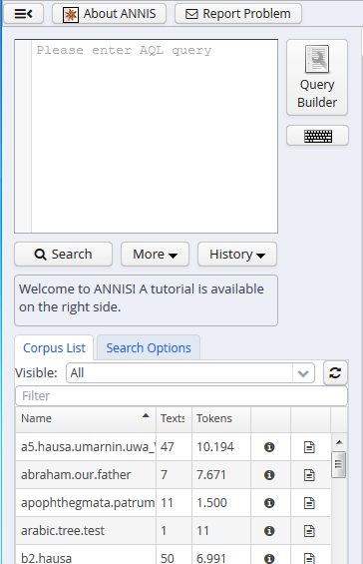
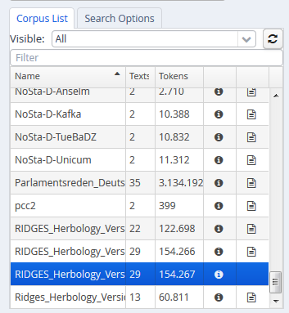
Interface Query window
Query can be built via the query builder
enter query, start with Cmd+Enter
corpus list
choose corpus by clicking – selected corpora highlighted in blue

Slide 15
ANNIS Query Language
oder: How do I tell ANNIS what I'm looking for?
two basic principles:
Variable-value pairs
Relations between variable-value pairs

Slide 16
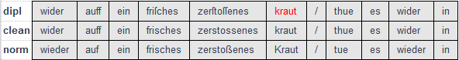
Tokens
Tokens are the smallest (technical) unit in a corpus.
A token usually, but not always, corresponsd to one orthographic word or punctuation mark!
You can search for this items in ANNIS.
Token Token Token Token Token Token ...

Slide 17
Principle 1: Variable-value pair
AQL
Name of annotation level →Variable dipl =
annotated category →value /kraut/
We have to know which variables are available!
Corpus metadata
annotation guidelines of the corpus (e.g. for RIDGES http://korpling.german.hu-berlin.de/ridges/download/pubs/annotationGuidelines_v4.1.pdf)

Slide 18
Principle I: Variable-value pairs
dipl= /kraut/
Prerequisite: Existence of a level called „dipl“. (Metadata!)
Expected result: finding all attestations of this character string on the level „dipl“ in the selected corpus (or corpora)
Variable (Layer, Tier, Ebene ...)
Wert
(Wort, Lemma, Satz, Wortart ...)

Slide 19
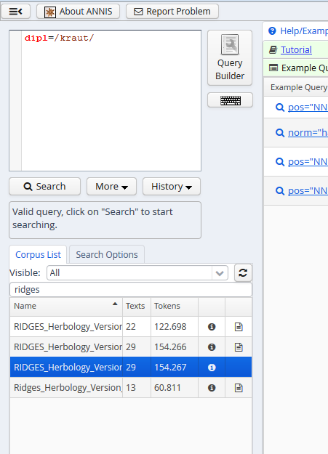
Interface Query
query language AQL
example queries for RIDGES corpus
shows if query is valid
for every query at least one corpus has to be selected

Slide 20
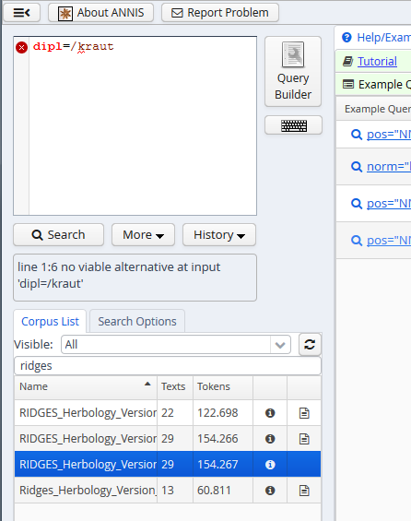
Interface Errors in the query
AQL with errors!
Feedback on the error

Slide 21
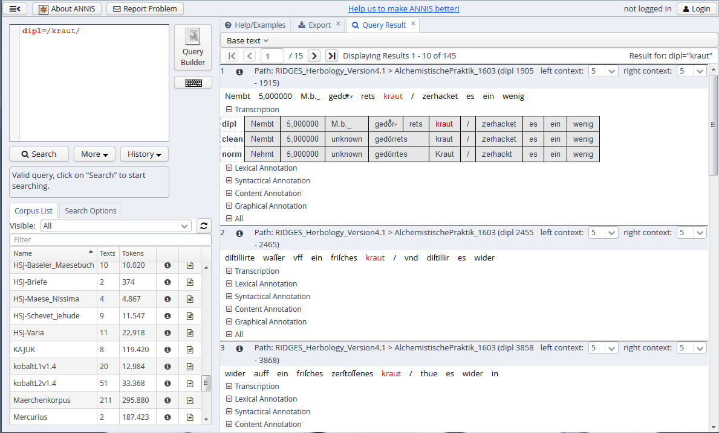
Variable-value pair dipl= /kraut/

Slide 22
Interface
Hits, visualization, metadata, search history

Slide 23
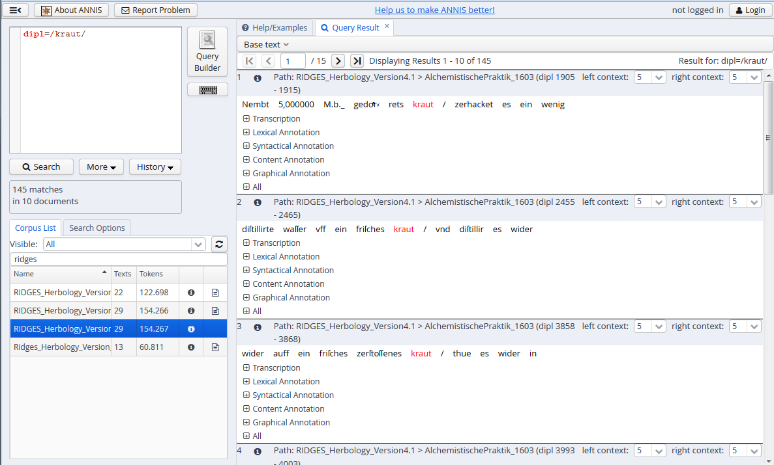
Interface hits
# of hits
Key word in Context (KWIC)
Grouping of annotations
set context

Slide 24
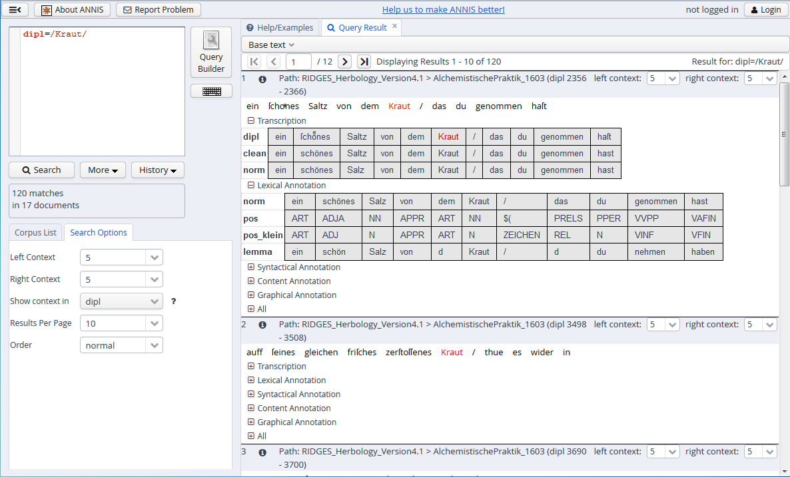
Interface Visualization
Query
# of hits
Partitur
Variables
(Annotation levels)
Values
(Annotation values)

Slide 25
Interface Metadata
document metadata + name of the document
corpus metadata

Slide 26
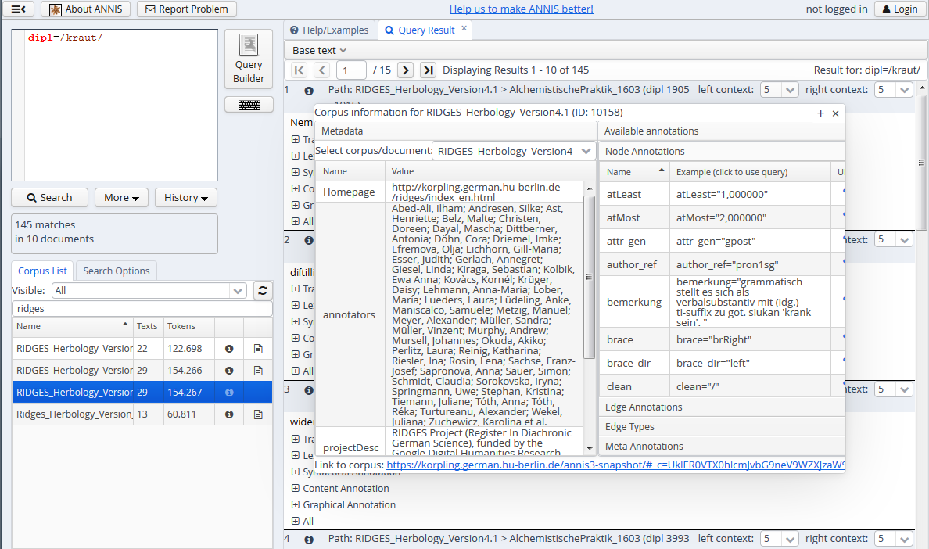
Interface Corpus metadata
List of all annotation layers (variables) of the corpus
corpus metadata
general information about the corpus

Slide 27
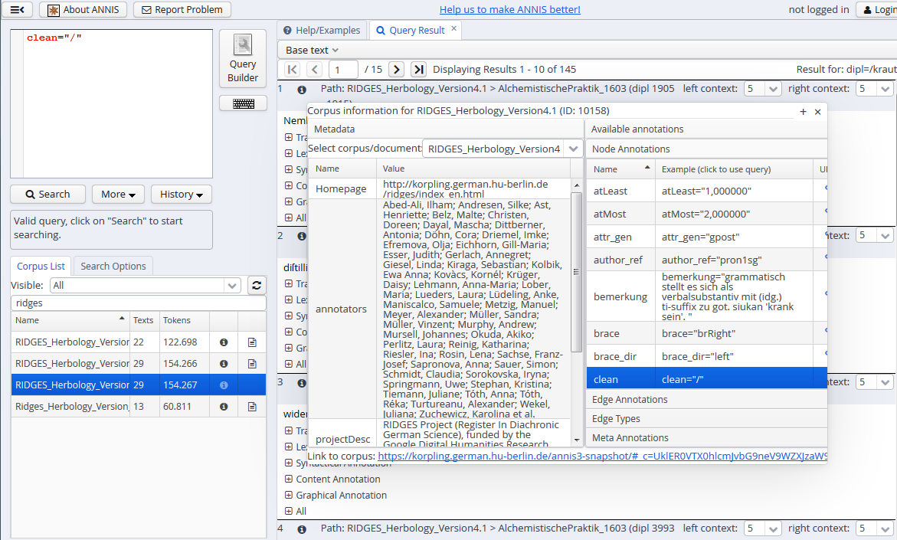
Interface Corpus metadata II
Click on an annotation level
-> is automatically pasted to the search field

Slide 28
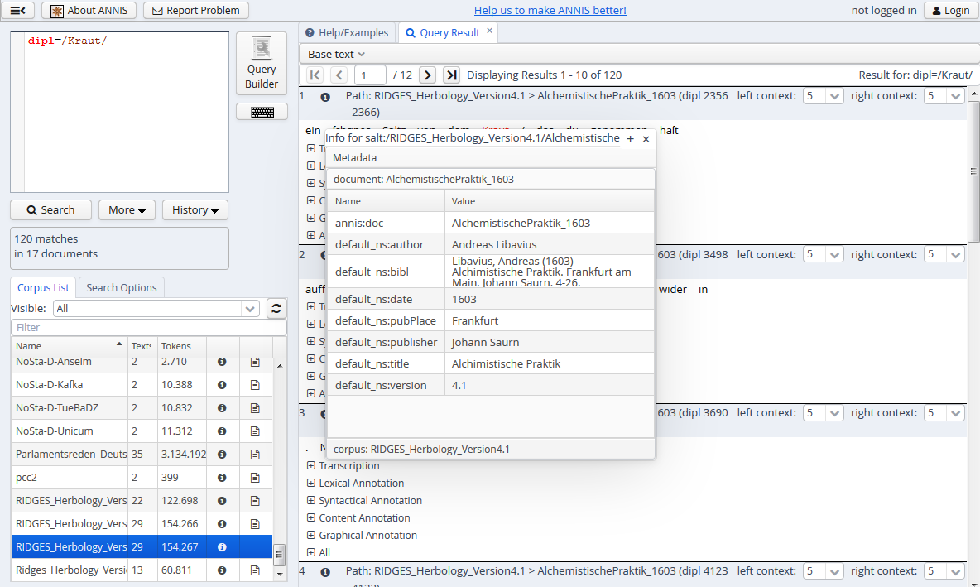
Interface Document metadata
Document metadata
Information on a document (text), e.g. author, year, title

Slide 29
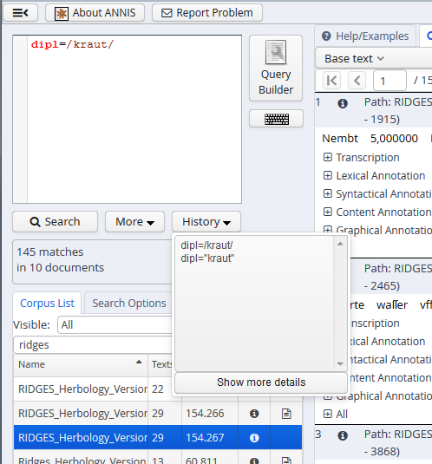
Interface Search history
Search history
List of all queries in a session

Slide 30
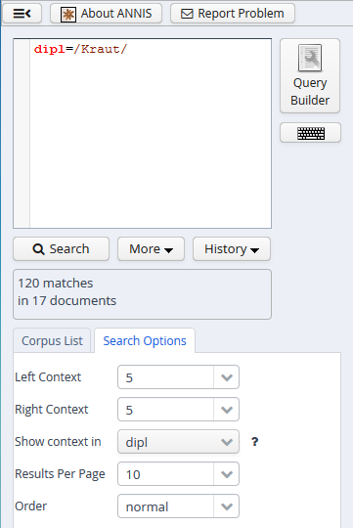
Interface Query options
set size of context
Which transcription level should be shown in the list of hits?

Slide 31
Historical texts
Variance in orthography and composition
some things are quite "unpredictable"
graphemic / (text)-structural information
line break, page break, page composition

Slide 32
Example Graphemic variants
Try to find all graphemic and inflectional variants of Kraut 'herb'!
use the fitting annotation layer (variable) for the query
most suitable variable would be lemma
and enter the value /Kraut/
lemma=/Kraut/

Slide 33
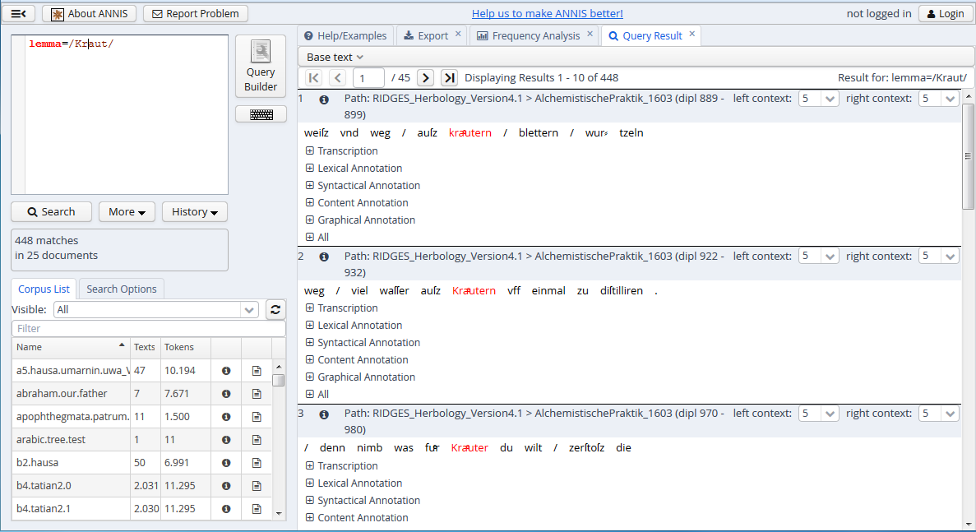
Example Graphemic variants

Slide 34
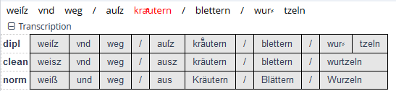
Normalization
Take a closer look at the hits for lemma=/Kraut/
Our query finds all historical word forms of Kraut attested in the corpus.

Slide 35
Example: Normalization
Search for the lemma of zusammensetzen!
We find very different historical spelling variants...
lemma=/zusammensetzen/
Hit 1
Hit 2
Hit 3

Slide 36
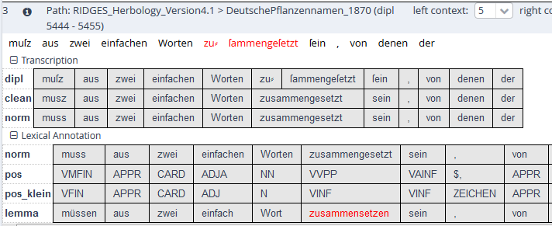
Example: Normalization
Stepwise normalization (dipl>clean>norm)
dipl: Unification/merging of historical spelling variants
POS and lemma annotation on the normalized level (norm)

Slide 37
Operators for pattern search
. any character
? 0 or 1 repetition (of preceding element)
* 0-infinitely many rep. (of preceding element)
+ 1-infinitely many rep. (of preceding element)
\\ verbatim (following element)
! not
(a|b) a or b (also: [ab])

Slide 38
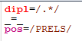
Important operators for pattern search
. any character
? 0 or 1 repetition (of preceding element)
* 0-infinitely many rep. (of preceding element)
+ 1-infinitely many rep. (of preceding element)
\\ verbatim (following element)
! not
(a|b) a or b (also: [ab])
[abc] set (or [^abc]=all except abc)
a{2,3} a 2-3times

Slide 39
important relations between VV pairs
. direct precedence
.* indirect precedence
_=_ identical coverage
_i_ inclusion
_o_ overlap
_l_ left overlap
_r_ right overlap

Slide 40
Example: Operators
Which results do you expect for the following pattern searchers? norm=/g.b./
gebe, gibt (for RIDGES, others are theoretically possible)
dipl=/r(a|o)t/
rot, rat (for RIDGES)
dipl=/meint?/
mein, meint (for RIDGES)

Slide 41
Example Part of speech
How can we find all common nouns (not proper nouns) in RIDGES?
relevant variable is pos
pos=/NN/

Slide 42
Example Part of speech
How can we find all adjectives in RIDGES?
What do the guidelines say (STTS)?
relevant variable here pos
STTS: difference between ADJA and ADJD
ADJA: attributive adjective, die schöne Katze 'the beautiful cat'
ADJD: predicative or adverbial adjectives, e.g. er fährt schnell 'he drives fast', er ist schnell ' he is fast'
pos=/ADJ./

Slide 43
Example: Querying annotation layers
Find out if there is a dedicated layer for headers in RIDGES!
Can we build a query that searchers for headers?
relevant variable is head
head=/head/

Slide 44
Example: Combining searches
Find the diplomatic word form Wermut occurring in headers!
relevant variables head and dipl
head=/head/
dipl=/Wermut/
What's happening?

Slide 45
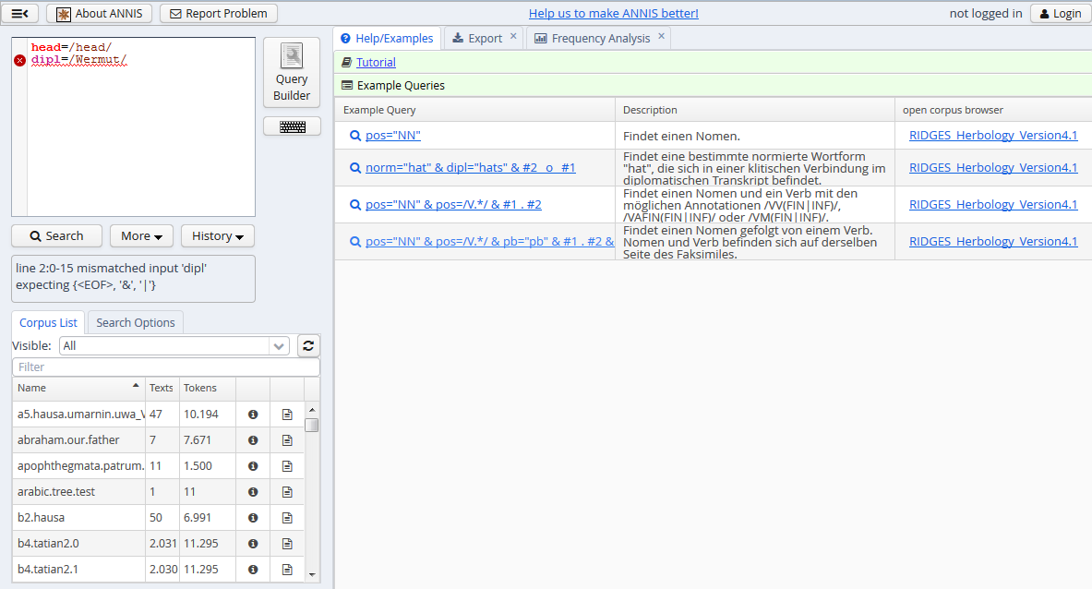
Aufgabe Kombinierte Suche
error ☺

Slide 46
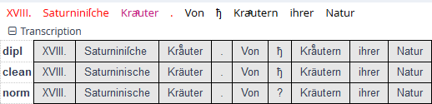
Principle II: Relations
head=/head/ VV pair1
_o_ Relation
dipl=/Wermut/ VV pair2
There are several types of annotations!
We have to know which relation these annotations can have to one another.
Spans (head) overlap with token annotations (dipl)!

Slide 47
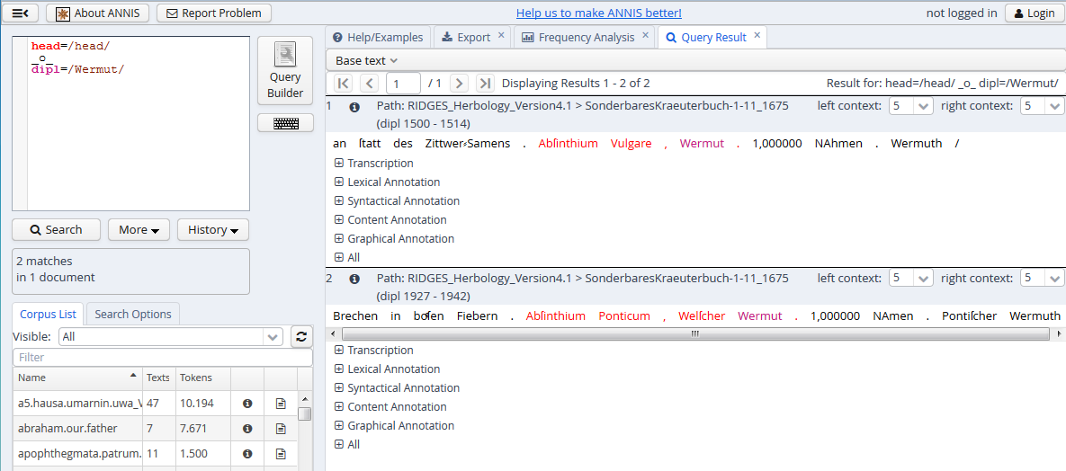
Aufgabe Kombinierte Suche

Slide 48
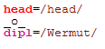
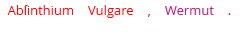
Syntax-Highlighting
one color per VV pair - some examples:
Red for all values of the variable head
Purple for all values of the variable dipl
The hits are marked in the same colors:
multiple tokens are red, as they occur in a header together
one token is purple because it is the dipl value we were searching for:

Slide 49
Example: Overlaps
Search for a verb that occurs in a header.
relevant variables: pos and head
Operator _o_
pos=/V.*/ _o_ head=/head/

Slide 50
Example: Identity
Look for all diplomatic word forms tagged as substituting relative pronouns.
relevant variables: dipl and pos
Operator _=_
dipl=/.*/ _=_ pos=/PRELS/

Slide 51
Example: Direct precedence
Search for an article directly preceding a noun.
relevant variable: pos
Operator .
pos=/ART/ . pos=/N./

Slide 52
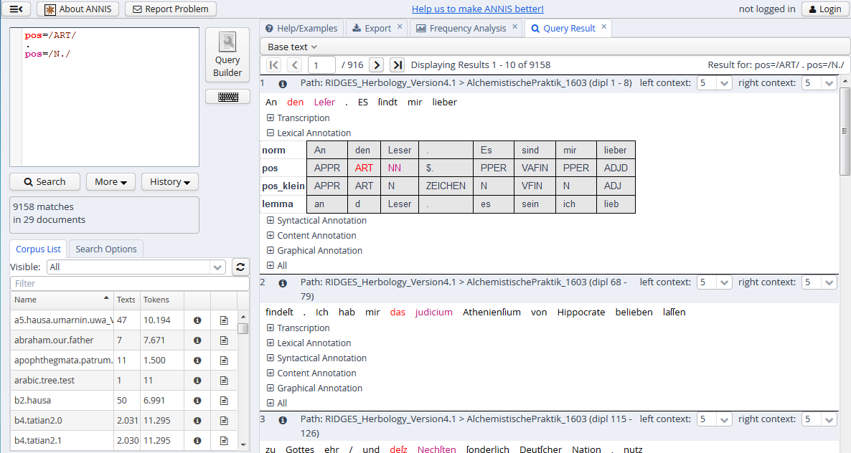
Example: Direct precedence

Slide 53
Example: indirect precedence
Search for an article (A) that indirectly precedes a noun (B). Why indirectly? You also want to catch a potential prenominal modifier (C) in your results: die schöne Katze.
relevant variable: pos
Operator . and distance 1,2 (read: I search A and B either in direct precedence or one token C can be in-between)
pos=/ART/ .1,2 pos=/N./

Slide 54
Example: Sequences
Search for a noun directly followed by a preposition which in turn is directly followed by an adjective.
relevant variable: pos
Operator .
pos=/N./ . pos=/APPR/ . pos=/ADJ./

Slide 55
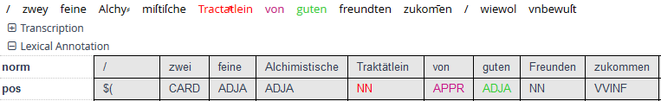
Example: Sequences
Search for a noun directly followed by a preposition directly followed by an adjective.
relevant variable pos
Operator .
pos=/N./ . pos=/APPR/ . pos=/ADJ./

Slide 56
Examle: Identity
Search for particle verbs containing the particle auf (e.g. aufwachen 'wake up')
relevant variables: lemma and pos
Operator _=_
pos=/VV.*/ _=_ lemma=/auf.*/

Slide 57
Examle: Identity
Search for particle verbs containing the particle auf (e.g. aufwachen 'wake up')
relevant variables: lemma and pos
Operator _=_
pos=/VV.*/ _=_ lemma=/auf.*/
What do we not find using this query?

Slide 58
Example: Metadata
Find out if the normnalized word form Blume can be found in a text from the year 1543.
If yes, how often?
relevant variables norm and meta::date
Verknüpfungszeichen &
norm=/Blume/ & meta::date=/1543/
2 matches

Slide 59
Hints
The list of hits only shows the annotation layers (variables) that have been annotated in the span that is shown. In other words, there might be more annotation layers that are not displayed because there are no annotations for the span currently displayed.
Take a look at corpus metadata and annotation guidelines to know which annotation layers are actually in the corpus.
Not all documents in a corpus necessarily have the same (number and type of) annotation layers.

Slide 60
Summing up
Querying ANNIS is based on
Variables (Annotation layers) and values (categories in the annotation layers), e.g.
Search for exact values, e.g. pos=/ADJA/
Search for patterns, e.g. pos=/ADJ./
variable-value pairs can be searched for in relation to one another, e.g.
Annotations can overlap
Annotations cover an identical area
Variable-value pairs can be searched for together with metadata, e.g.:
pos=/ADJA/ & meta::date=/1870/

Slide 61
Interface
Export, Frequency analysis

Slide 62
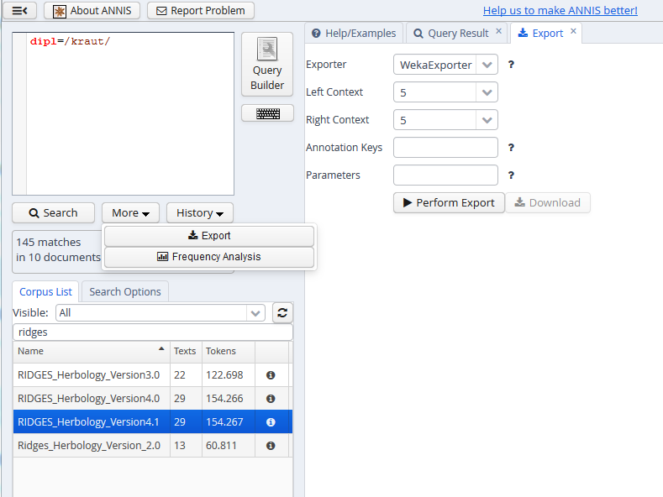
Interface Exporting hits
Choose type of export, format, context, annotation layers
see "More"

Slide 63
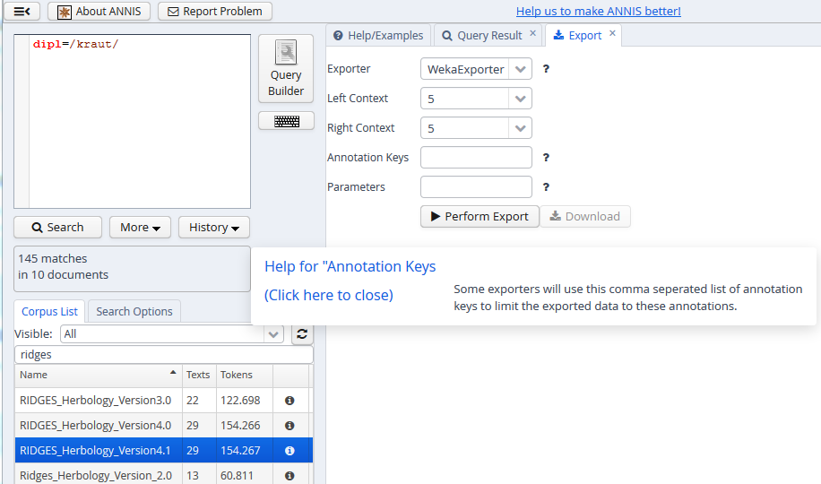
Interface Exporting hits
help

Slide 64
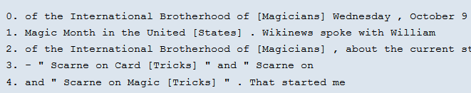
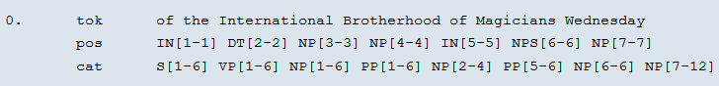
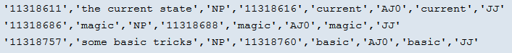
Interface Exporting hits
Text-Exporter
Grid-Exporter
CVS-Exporter

Slide 65
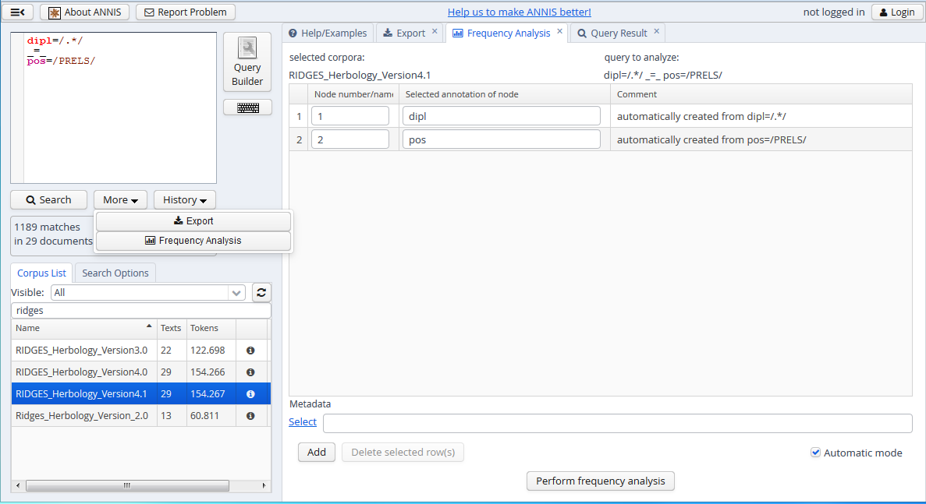
Interface Frequency Analysis
Query has already been formulated
Example: finding all word forms (dipl) annotated as PRELS (pos)
go to „More“
start of frequency analysis
Notes:
PRELS: substituting relative pronoun, e.g. dafür, dabei, deswegen, trotzdem

Slide 66
REM

Slide 67
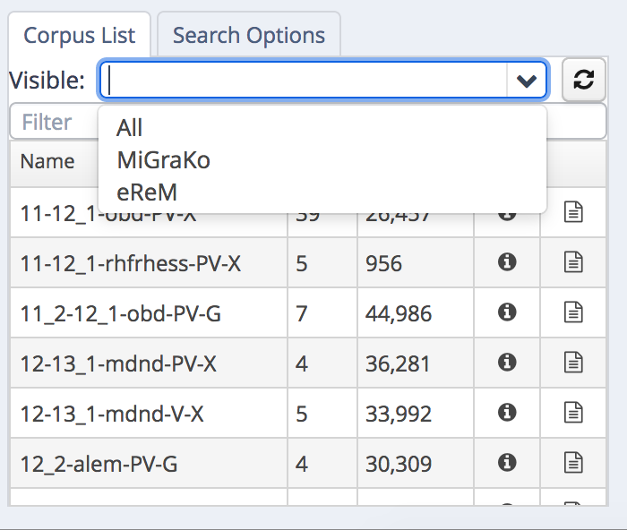
REM: Choosing a corpus
MiGraKo: Corpus of MHD Grammar
eReM: Additional texts
Notes:
eReM enthält z.B. ALLE frühmhd. Texte, die nicht in MiGraKo sind – für die frühmhd. Zeit ist es also genauso flächendeckend wie das Referenzkorpus Altdeutsch fürs Ahd., das ALLE aus dieser Zeit verfügbaren Quellen enthält. "eReM ist also für sich genommen kein strukturiertes Korpus wie MiGraKo. Es bietet
zum einen aber die Mšglichkeit, MiGraKo durch Hinzunahme strukturell passender eReM-Texte oder -Textausschnitte zu erweitern, und zum andern die Mšglichkeit nahezu
flŠchendeckender Recherchen im Bereich des Frühmittelhochdeutschen."

Slide 68
Find individual tokens
very easy – but not always helpful, see
"so"
"mann"
"vrouwe" – keine Treffer

Slide 69
Lemma search
Lemmas in REM are MHG lemmas (as in MHD dictionary)
in case of doubt, check mhdwb.de to search for the right lemma (or use the query builder)

Slide 70
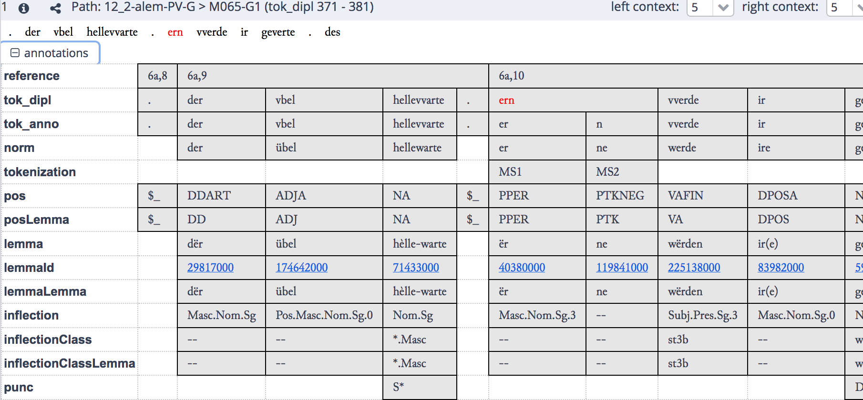
Layers in REM
Notes:
hier: klitisierte Negationspartikel. Auf der tok_anno-Ebene ist das Klitikon von der Basis getrennt und auch unabhängig von der Basis lemmatisiert.

Slide 71
Example: Negation in MHG
We want to investigate the development of negation in MHG:
"double" negation with en and niht vs. simple negation
What do we have to look for?
Notes:
zunächst feststellen, wie Negationspartikel en- annotiert ist – als en oder ne? Wird auch so etwas wie ni davon erfasst?
lemma=/ne/ ^1,10 lemma=/niht/ --- leider nicht möglich, innerhalb eines Satzes zu suchen, daher muss man Fehltreffer manuell aussortieren. Hat man das Korpus heruntergeladen und arbeitet mit einer lokalen Installation von ANNIS, kann man allerdings den Default Context für die Suche in den Einstellungen ändern.

Slide 72
Example: Conversion in MHD
We want to find all nominalized infinitives in MHG (e.g. NHG das Singen, das Tanzen)
We can use the pos and posLemma annotation for that purpose.
Notes:
pos!=/APPR|PTK.*/ . pos=/NA/ _=_ posLemma=/V.*/ ---- Problem: oft der Infinitiv in zu + Infinitiv als NA markiert (warum auch immer), daher muss man APPR und PTK ausschließen

Slide 73
Finding individual tokens
Pay attention for spelling variants (upper-/lowercase!)
so only finds lowercase attestations, So only uppercase ones
For finding all variants, we use regular expressions

Slide 74
Finding individual tokens
"so" | "So" | "SO"

Slide 75
Finding individual lemmas
Important: Attributes can have different names!
Example: The layer that is called "lemma" in virtually all other corpora is called "hw" in the British National Corpus.

Slide 76
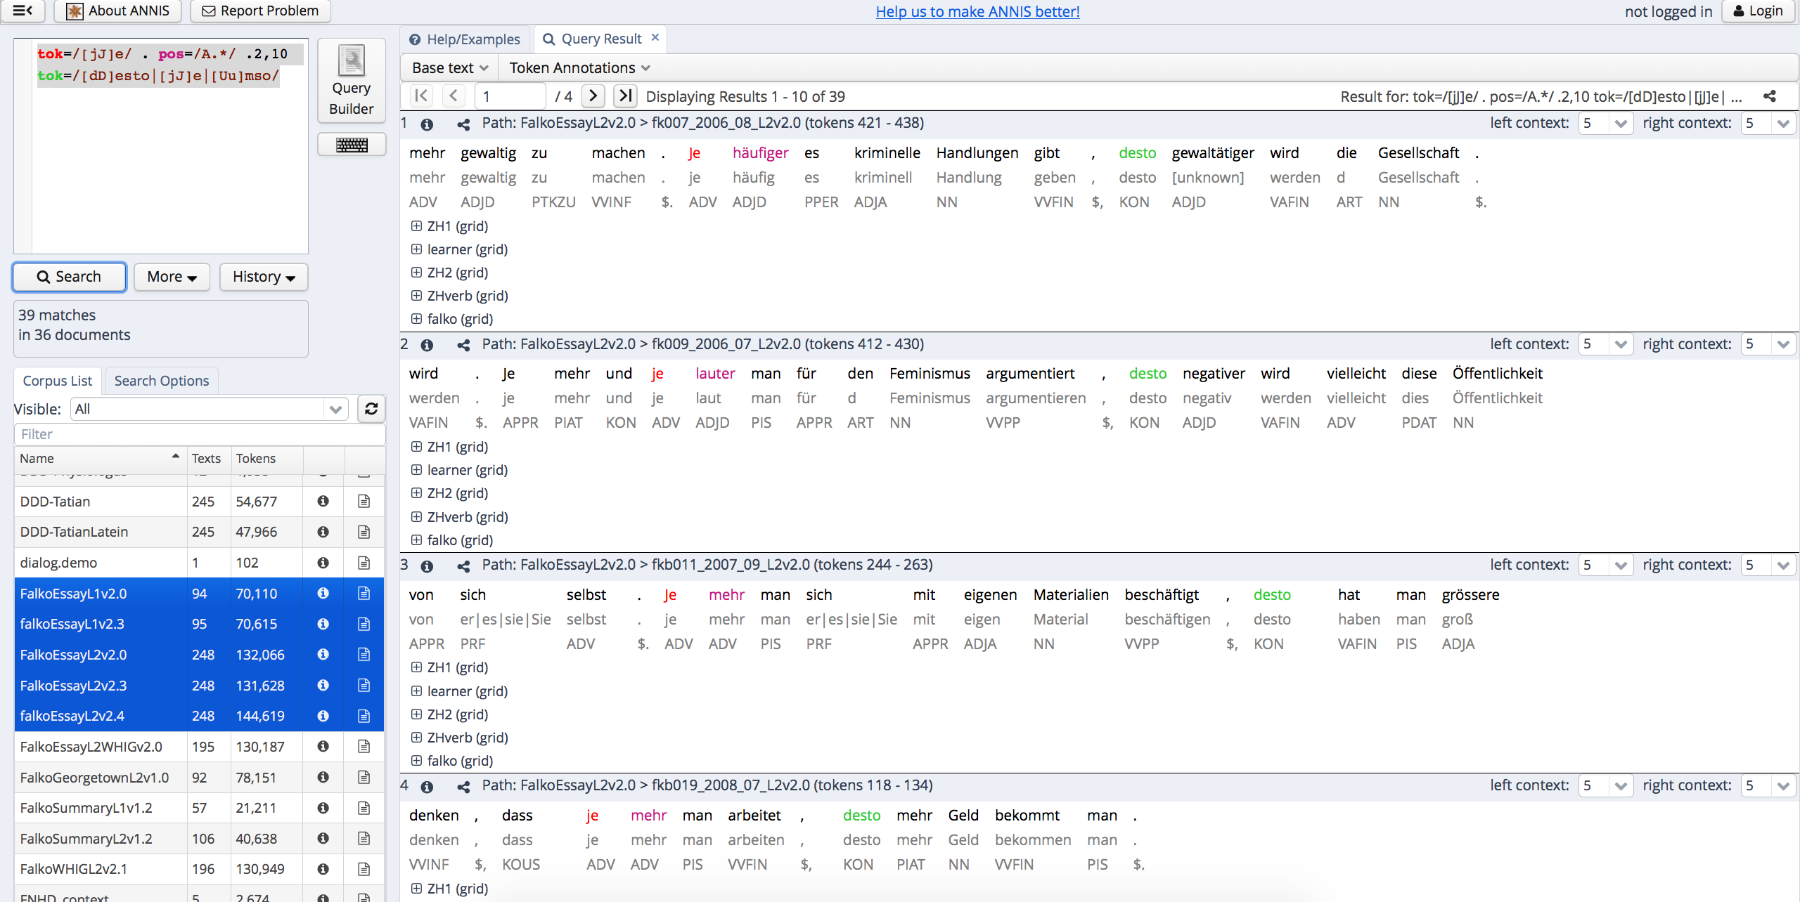
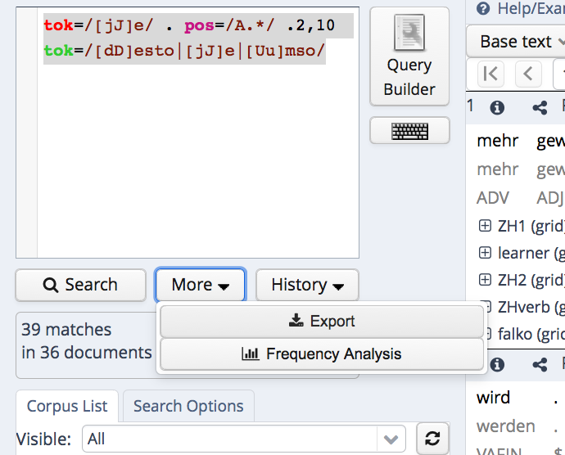
From result to export file

Slide 77
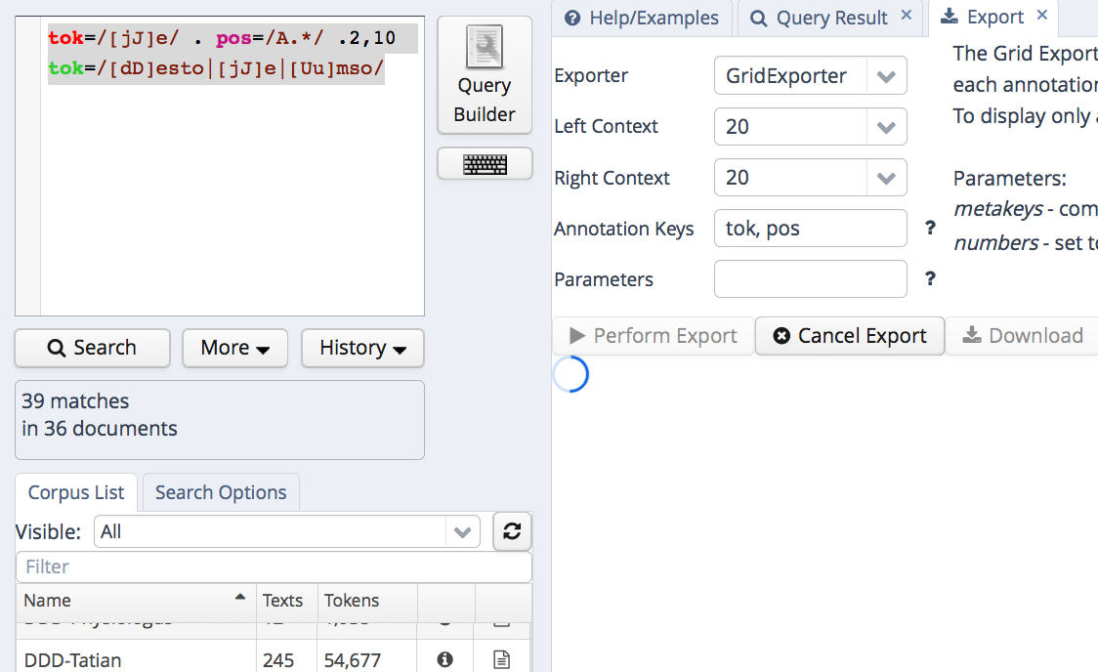
From result to export file

Slide 78
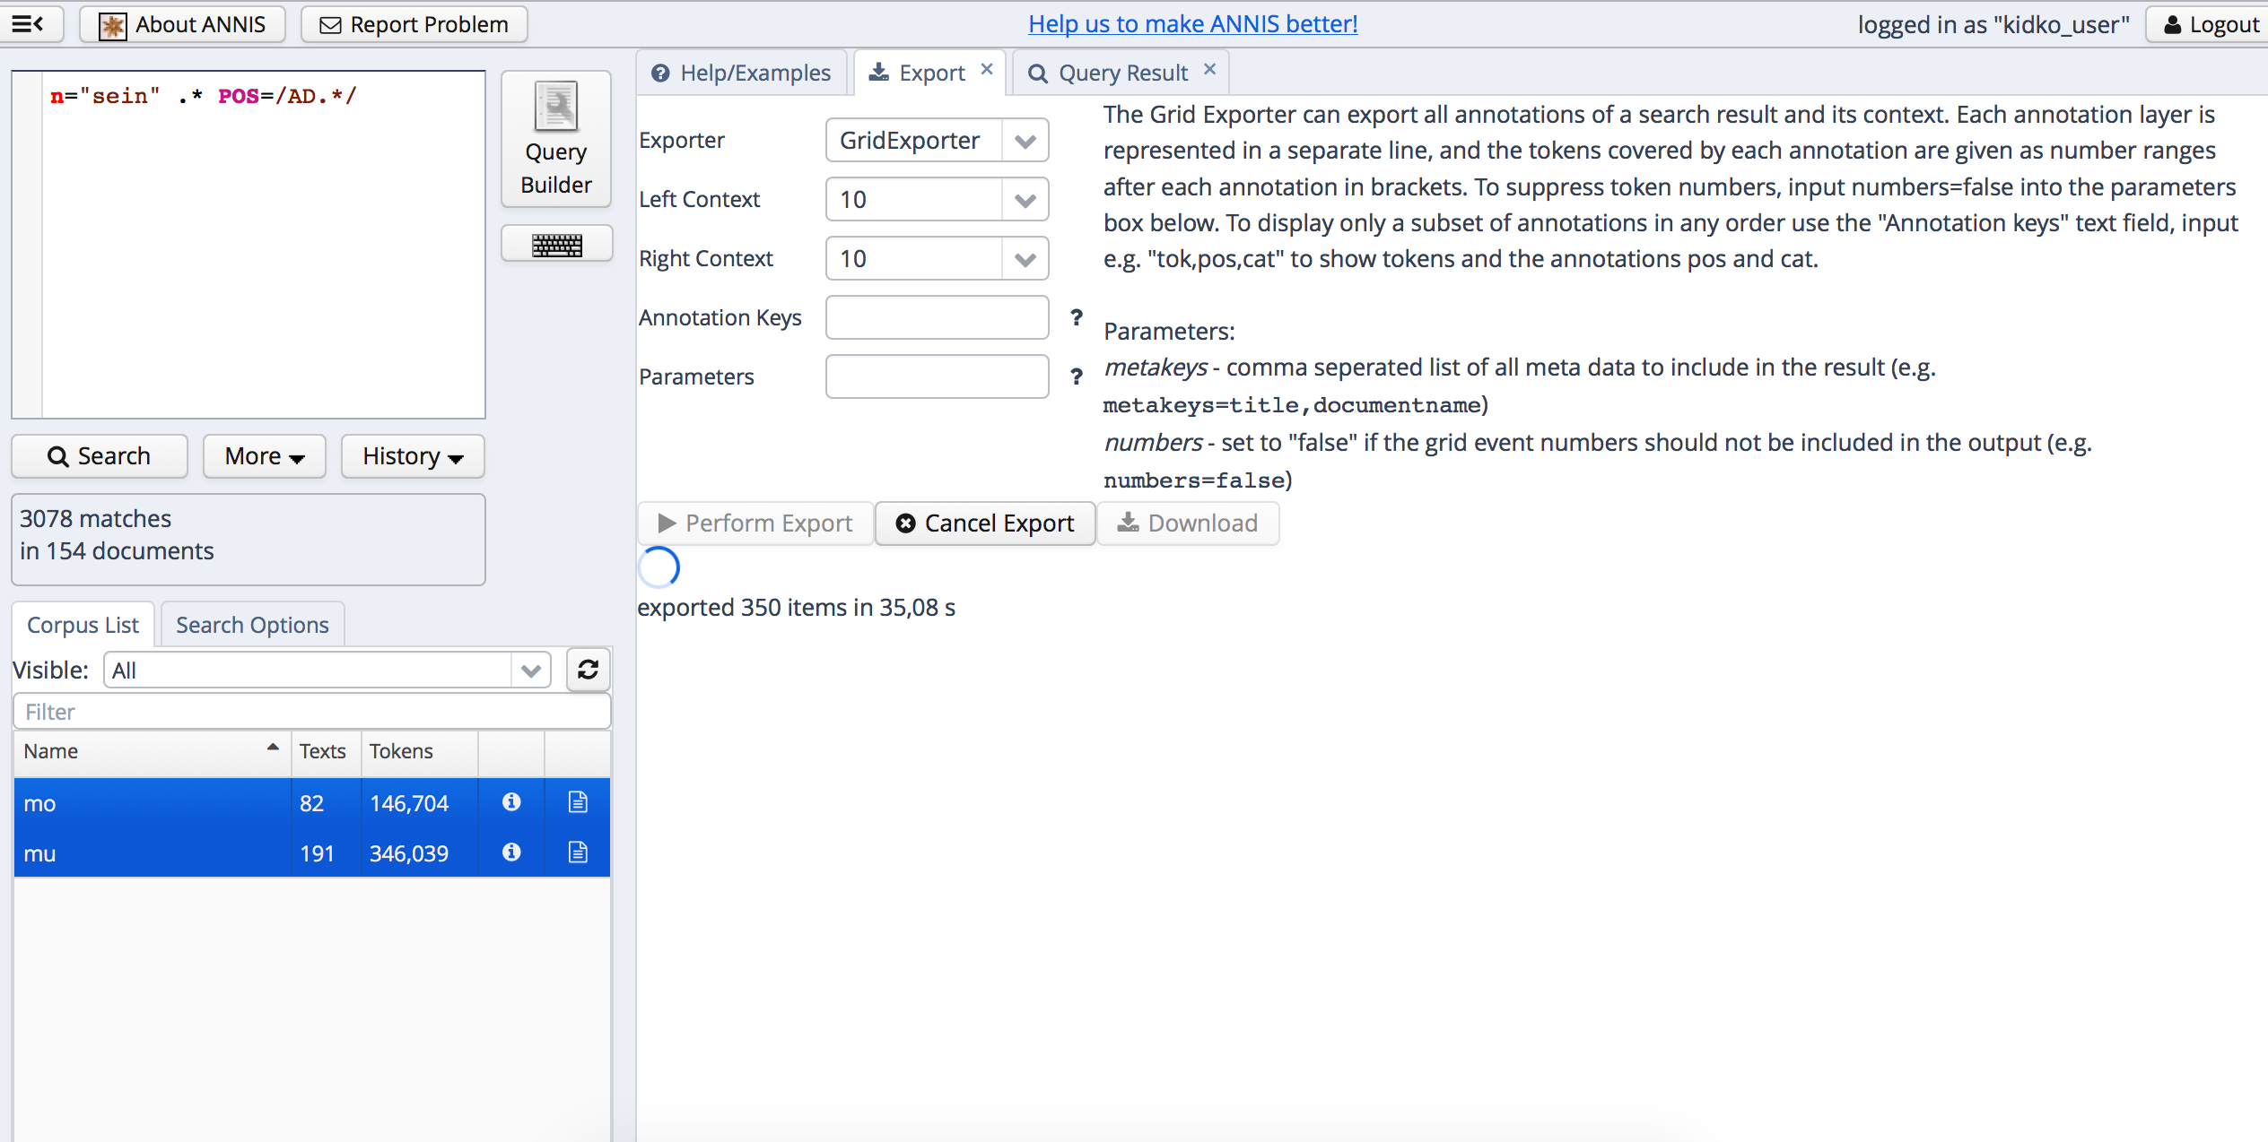
Export
not all exporters work for all ANNIS corpora ☹

Slide 79
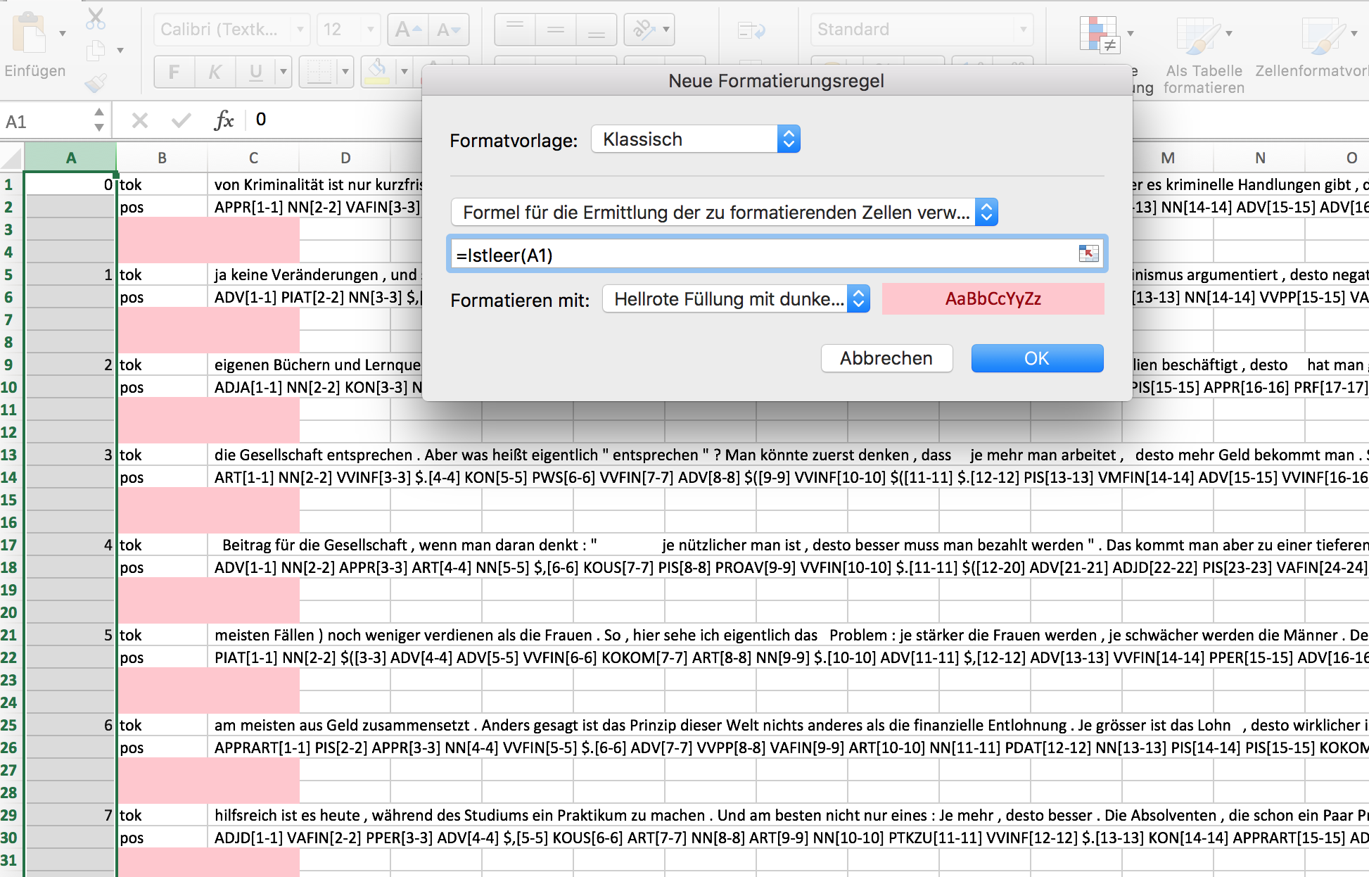
Using conditional formatting in Excel

Slide 80
Treebanks
syntactically parsed corpora
syntax represented via syntactic trees
a syntactic tree consists of edges and nodes
widespread tagset for German: Tagset of the TIGER treebank (Albert et al. 2004)

Slide 81
Constituent vs. dependency structure
two key syntactic formalisms
Constituent structures: Words are grouped into phrases, with one word functioning as head in each phrase.
Example:
Eine Stute ist ein weibliches Pferd.
S
.
NP
VP
NP
Eine
Stute
ist
ADJP
(based on Kübler & Zinsmeister 2015: 57)
ein
weibliches
Pferd
Notes:
Eine Stute ist ein weibliches Pferd: Welche Phrasen finden wir hier? Wie kann man den Satz unterteilen?

Slide 82
Constituent vs. dependency structure
Dependency structure: Relationships between word pairs (head and dependent)
p
oprd
nmod
nmod
sbj
nmod
Eine Stute ist ein weibliches Pferd .
(based on Kübler & Zinsmeister 2015: 58)
Notes:
oprd: Prädikat – Eine hängt vom Kopf Stute ab; die Dependenz ist vom Typ nominal modifier. myth wiederum ist vom Kopf is abhängig, und die Dependenz ist vom Typ Subjekt. oprd steht offenbar für Objektsprädikativ, obwohl es sich hier gar nicht um ein Objekt handelt...

Slide 83
Constituent vs. dependency structure
both analyses assume hierarchical structuring of sentences
but: in constituent structure analysis constituents (i.e. abstract entities) are ordered hierarchically
dependency analysis, by contrast, is constrained to the words themselves.
Constituent structure represents syntactic categories, dependency structure takes syntactic functions into account.
(see Lemnitzer & Zinsmeister 2015)

Slide 84
Hybrid models
some projects use a mixture of both variants
advantage: being able to take both syntactic categories and syntactic functions into account.

Slide 85
Terminology
"Constituent": category-neutral description of a phrase
A phrase is always assigned a specific category, e.g. VP, NP
Apart from phrases, syntactic analysis has started to work increasingly with chunks
Chunks are prosodic units of speech (recognizable by small pauses in spoken language) or multi-word units that belong together.
Notes:
Viel Forschung zu Chunking in der Psycholinguistik; dort wurde gezeigt, dass wir Sprache quasi in Mehrworteinheiten herunterbrechen; so entstehen quasi Routinen, wie wir sie auch aus anderen Bereichen kennen (z.B. Autofahren: Kupplung treten, Gang einlegen, Gas geben... ohne dabei wirklich bewusst nachzudenken); im hochfrequenten Bereich kommt es so dazu, dass Wörter quasi zu einer Einheit verschmelzen (weißt du > weisse).

Slide 86
Historical treebanks of German
Mercurius corpus
Newspaper texts from two different years: Annus Christi 1597, Mercurius 1667
Deutsche Diachrone Baumbank
c. 2500 Tokens from two texts each for OHD, MHG, ENHG

Slide 87
Syntax tree: Example
Node
Edge label
Edge
NP
NK
NK
die
Katze
Notes:
NK = noun kernel (nominaler Kern / Element der Kern-NP)
Wurzelknoten: Syntaxbäume wachsen verkehrt herum, mit der Wurzel nach oben. In diesem Beispiel ist der Wurzelknoten auch der terminale Knoten, also der erste Knoten auch der letzte.

Slide 88
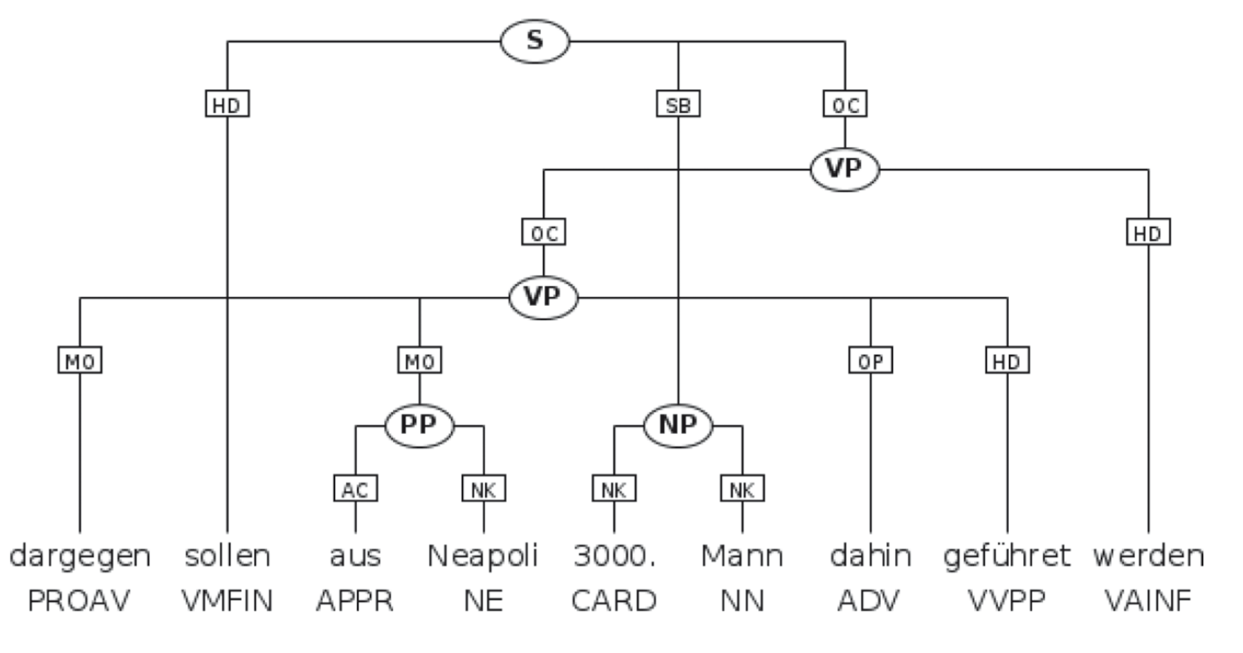
Crossing edges
Notes:
Abbildung 538 zeigt einen Beispielsatz aus der Mercurius Baumbank, in dem die Konstituenten dargegen, aus Neapoli und dahin vom eingebetteten Verb gef̈hretu abhängen und nicht von den übergeordneten Auxiliar- bzw. Modalverben werden und sollen. Dadurch ergeben sich kreuzende Kanten.
(Bei kreuzenden Kanten spricht man mathematisch nicht von Bäumen, sondern von "allgemeineren Graphenstrukturen"...)

Slide 89
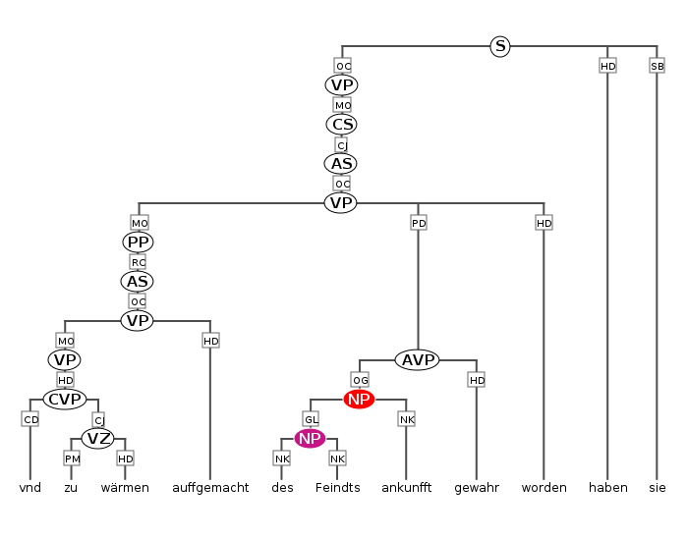
Example: Mercurius

Slide 90
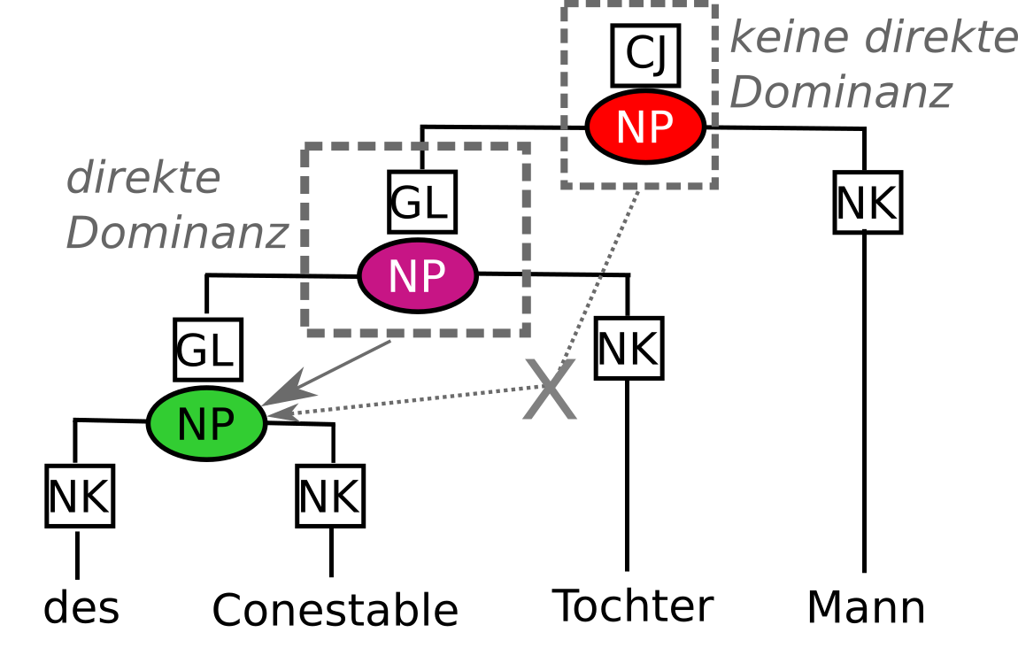
Example: Mercurius
node > [label="GL"] cat="NP"
any
node
direct
dominance
edge
label
noun phrase
Notes:
label=GL bezieht sich auf die Relation zwischen dem Knoten und der NP
CJ = Konjunkt (d.h. die NP ist offenbar in eine Koordinationsstruktur eingebettet)

Slide 91
Example: Mercuris
What can we find using the following queries?
node > cat="NP",
node >[label="GL"] cat="NP" & meta::doc="Mercurius-1667"
node >* cat="NP"

